Slide 1
Gender Responsive Infrastructure Development
Presented By
Dr Sunita Pitamber
Dr Zeinab El Bakri
Savanas E Enseadas
Lisbon - Portugal

Slide 2
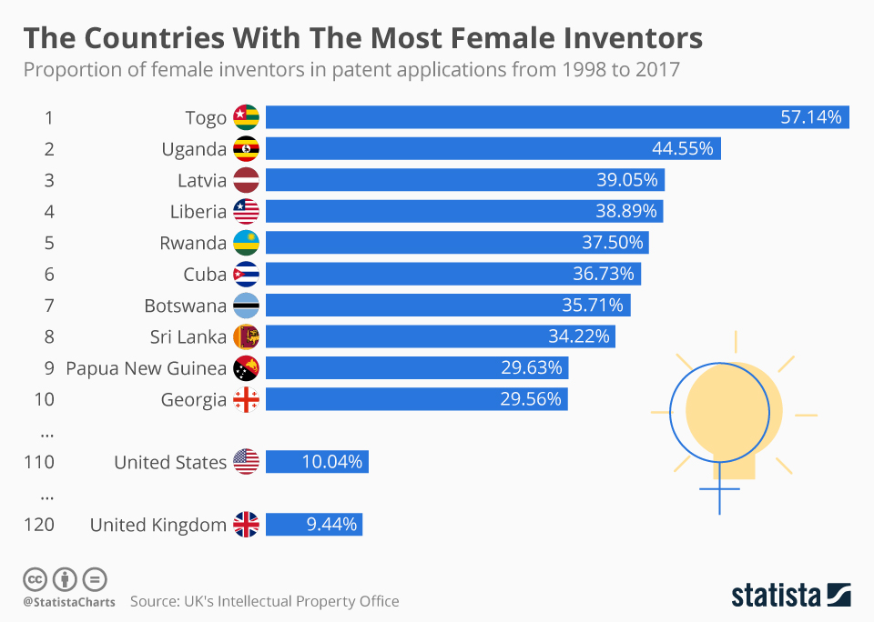
Facts
Stephanie Kowlek
Invented the bullet proof fibre which now protects police and soldiers all around the world

Slide 3
Gender Responsive Infrastructure Development
Proposed Agenda
TIME (GMT) | AGENDA ITEM
10:00 to 10:15 | Risks to Agenda 2063 from gender-blind infrastructure: Outlining the Problems and issues of Women’s Reduced Participation and Exclusion from the Infrastructure Sector
10:15 TO 10:35 | Introduction the GRID: the need for well-defined gender-mainstreaming guidelines for infrastructure practitioners
10:35 TO 11:05 | A step-by-step overview the GRID
11:05 TO 11:25 | Overview of the Policy Brief: beyond gender-neutrality in infrastructure
11:25 TO 12:00 | Q&A Moderated by PIDA Coordinator

Slide 4
Gender Responsive Infrastructure Development
Gender blind infrastructure
risks reducing the achievement of Agenda 2063 Vision

Slide 5
PIDA Promotes Gender Responsive Infrastructure Development
The Agenda 2063:
  Aspiration 1: Undertake all actions necessary to achieve continent-wide poverty reduction, sustainable development and inclusive growth.
  Aspiration 2: Outline the need to promote and develop critical sectors and drivers of economic growth such as continental infrastructure development.
  Aspiration 6: Reiterated and provided a clear emphasis on the need to promote women’s economic empowerment as follows: “An Africa whose development is people-driven, relying on the potential of African people, especially its women and youth, and caring for children”.

Slide 6
PIDA Promotes Gender Responsive Infrastructure Development
The AU Gender Equality and Women’s Empowerment Strategy prioritises
The SDGs: Besides Goal #5, women’s participation affects all other Goals
PIDA partners are strongly committed to ensuring that investments in PIDA projects and all other infrastructure projects in AU Member States are gender-responsive
  April 2019: Second Ordinary Session of the African Union (AU) Specialized Technical Committee on Transport, Transcontinental and Interregional Infrastructure, Energy and Tourism
  November 2019:
    African Network for Women in Infrastructure (ANWiN) Launched
    Government representatives and partners at PIDA Week declare support for the ANWIN

Slide 7
Women’s participation in infrastructure development
Infrastructure development is not gender neutral;
Infrastructure affects women and men differently, due to how they use infrastructure;
For infrastructure to be truly sustainable its benefits must be gender inclusive;
Gender responsive infrastructure can contribute to widening women’s economic opportunities and contribute to gender equality
Economic Empowerment
Time
Gendered Poverty
Violence against women and girls
Mobility
Discriminatory social norms and practices

Slide 8
Risks of Gender Blind Infrastructure development in Africa
Opportunities
Challenges
92 % of SDGs depend on availability of infrastructure
Africa will each year add 25 million people to its workforce
Rapid urbanization and improved infrastructure can increase Africa’s consumer spending which was around US$680 billion (2017) and projected to increase to USD 2.2 trillion by 2030
Women make up more than half of the projected consumer spending
PIDA PAP 2 is has integrated gender into the infrastructure development cycle
Yet the infrastructure gap in Africa stands at USD 170 billion
Challenge of jobs, food security, and infrastructure needs
Risk of localized conflict and neighborhood effect of fragility can lead to pressure on urban infrastructure and services
Insufficient gender responsive focus under PIDA PAP1
Capacity to focus on women’s participation in PIDA supported projects at RECs requires strengthening
Sustainable integration of women’s participation in infrastructure development

Slide 9
Risks of Gender Blind Infrastructure development in Africa
Missed Opportunities
Women’s equal economic participation can increase Africa’s GDP by USD 316 Billion by 2025.
Africa’s GDP can increase by USD 14 Billion by increasing digital access for women
Women make up approximately 70% of cross-border traders in Africa, most in informal sector.
While 2.5 million new engineers and technicians are required in SSA alone to meet SDGs:
  Women represent only 7% to 12% of engineering students in Africa
E.g.: Only 10% of female engineering students in South Africa and 8% in Kenya join the workforce after graduation
Changing Perceptions
Women and men have different needs and uses of infrastructure
Infrastructure is perceived as a sector for men due to the existence of heavy machinery and inputs
Lack of female role model in the industry
National Policies not encouraging women to enter this field
Addressing Risks
Gender Based Violence and sexual exploitation of girls
Poor long-term sustainability of infrastructure and its Operations and Maintenance aspects

Slide 10
Advantages of Gender Responsive Infrastructure development in Africa: Some examples
Benin: Solar Market Gardens
Solar-powered drip irrigation systems
Led to increase women’s income
Improved food security for their families
Paid for expenditures including school fees and medical treatment.
Kenya Last Mile Connectivity Project
Conducted a gender analysis and stakeholder consultation
These findings informed the design of the infrastructure especially the location of the Transformers
Leading to increasing the number of households connected including female headed households
Led to reduced cost of connection per household
Reduced women’s dependency on kerosene and wood
Improving women’s overall economic opportunities and health
Forum for African Women Educationalists (FAWE). Implemented in 13 African Countries to increase the number of girls accessing STEM and pursuing engineering disciplines

Slide 11
Gender Responsive Infrastructure Development
The Gender Responsive Infrastructure Development (GRID) guidelines
The need for well-defined gender-mainstreaming guidelines for infrastructure practitioners

Slide 12
The Goal and Objectives of GRID guidelines
The AUC and AUDA have committed to addressing gender equality through the Program for Infrastructure Development in Africa (PIDA) PAP2.
The overall aim of the PIDA GRID Guidelines is to provide practical guidance to Member States (MS) and Regional Economic Communities (RECs) including all PIDA partners involved in infrastructure project planning, design and implementation;
The specific objectives of the GRID-Guidelines are to:
  Support MS, REC focal points (and other stakeholders) in ensuring gender-responsive planning, designing, implementing, monitoring and evaluating of infrastructure projects
  Promote sustainable infrastructure development through effective gender analysis and mainstreaming in infrastructure development interventions, and
  Showcase the potential impact and benefits to MS of gender-responsive infrastructure development.

Slide 13
Mainstreaming Gender Throughout the PIDA Project cycle
Gender Equality Policies / Gender Data and Analysis / Stakeholders
Gender-Responsive Procurement Actions / Gender Mainstreaming in Project Monitoring & Evaluation (M&E)
S0:
Enabling Environment & Needs Assessment
S1:
Project Definition
S2A:
Pre-Feasibility
S2B:
Feasibility
S3A:
Project Structuring
S3B:
Transaction Support & Financial Close
S4A:
Tendering
S4B:
Construction
S4C:
Operation
Gender Mainstreaming in Project Identification and Analysis: S0 -> S3A
Gender Responsive Selection Criteria Process

Slide 14
Users of the GRID Guidelines
The users of the GRID Guidelines are expected to be, but are not limited to:
  PIDA coordinators in Member States and RECs
  Respective Ministry of Gender/ Women (as applicable in MS)
  Experts in infrastructure line ministries and agencies
  Experts involved in Feasibility studies and Environmental and Social Assessments
  Financing agencies
  Civil Society
  Private sector

Slide 15
GRID Guidelines
Gender Mainstreaming in Project Identification and Analysis
Existence of national laws which ensure gender-responsive actions in infrastructure sectors
Public agency assigned to assess policy compliance with gender-responsive legislation.
Bodies responsible for gender equality have demonstrated effectiveness and requisite power implementing their mandates.
Bodies responsible for gender equality are well resourced (in terms of budget, staff, meeting rooms, etc.).
Bodies responsible for gender equality have cultivated relationships with the national women’s machinery, civil society organizations, the private sector, the media and others.
Demonstrated positive impact on gender equality.
Existence of gaps in gender training, mainstreaming policy, and affirmative action (e.g., targets for recruitment).
Gender balance in stakeholder groups and implementing agencies

Slide 16
Gender Responsive Infrastructure Development Screening Criteria in the InCorrA
Screening Criteria:
  Each PIDA PAP 2 project will propose procurement related actions that could increase women’s opportunities to participate in the infrastructure value chain.
  Screening methodology:
  The project under consideration will be screened to focus on increased participation of women in the infrastructure value chain as a result of proposed procurement actions.
  The project design may choose to include all the six procurement related actions proposed or it may propose that a combination of these actions are taken into consideration while providing explanation for their suitability within the proposed action design
  The proposed scoring and weighting of the criteria can be further clarified and strengthened when the project design team adds explanations on how the proposed action will have the desired output/ outcome.

Slide 17
Gender Responsive Infrastructure Development Screening Criteria in the InCorrA
Gender Responsive Infrastructure Planning and Implementation Scoring
 | Gender Responsive Infrastructure Action Proposed | Score
1 | Project includes between zero or one procurement related action proposed in the screening methodology to support women’s participation in the infrastructure value chain. | 1
2 | Project includes two procurement related actions proposed in the screening methodology to support women’s participation in the infrastructure value chain. | 2
3 | Project includes three procurement related actions proposed in the screening methodology to support women’s participation in the infrastructure value chain. | 3
4 | Project includes four procurement related actions proposed in the screening methodology to support women’s participation in the infrastructure value chain. | 4
5 | Project includes five or more procurement related actions proposed in the screening methodology to support women’s participation in the infrastructure value chain. | 5

Slide 18
Gender Responsive Infrastructure Development Screening Criteria in the InCorrA
Some gender sensitive procurement related actions that a project can propose are (but not limited to):
  Actions that may support preferential procurement of women-owned SMEs or gender-certified businesses as subcontractors,
  Capacity building of contractors and state institutions in methodologies for increasing women’s participation;
  Training women business owners to get appropriate national certification;
  Evaluation criteria in the bidding documents that are drafted with the aim to encourage female suppliers or vendors,
  Establish standards for bidders to demonstrate track-records with regard to promoting gender-inclusive activities; and
  Establishing gender responsive monitoring and reporting systems. Benchmarking and monitoring are key in assuring that the proposed impact of this feature is achieved.

Slide 19
GRID Guidelines
Gender Mainstreaming in Project Design and Implementation
Ensure benefits to women, such as new training, employment and income opportunities, or increased access to new markets, education and/ or health facilities, additional security for women and girls against violence, are integrated in the project design
Ensure that all the proposed gender-responsive features, whether in the infrastructure design and/ or impact, are properly captured as needed in the relevant sections of the tender document
Include detailed costs of proposed gender specific actions in the project financing plan
Ensure the Project Implementation Unit and relevant line ministries continue to monitor and report on gender mainstreaming efforts

Slide 20
GRID Guidelines
Gender Mainstreaming in Monitoring and Evaluation
Ensure sex disaggregated data collection and reporting systems are established
Establish realistic targets that aim to advance gender equality.
  Separate targets for males and females and by relevant age groups.
  Check assumptions: Would an intervention targeted to vulnerable children and families benefit all families equally?
Ensure that the project results matrix/log frame clearly outlines the gender specific activities at all levels.
  That is, project objectives, inputs, outputs, and outcomes.
  The actions in the log frame should be clear, measurable, and show clear alignment to sustainable outcomes. In addition, each activity must be clearly costed within the overall project budget.
Determine whether the project objectives and specific components effectively address gender issues.

Slide 21
Gender Responsive Infrastructure Development:
End of Section on GRID

Slide 22
Gender Responsive Infrastructure Development
Policy Priorities for
Gender Responsive Infrastructure
The need for well-defined gender-mainstreaming policies for infrastructure policy makers

Slide 23
The PIDA Policy Engagement
  Policy harmonisation for gender issues in the infrastructure sector
  To ensure gender-related goals and women's empowerment on the continent
The PIDA Policy Engagement
The PIDA Steering Committee (PIDA-SC), RECs, and Member States committed to
Specific objectives of Policy Brief
Targeted Audience (not limited to)
  To identify the key policy constraints within the infrastructure institutional architecture and enabling environment that constrain women’s participation as users and contributors to the infrastructure life cycle in Africa; and
  To present priority policy priorities for the consideration of the PIDA SC to be further recommended for discussion and consideration by MS, RECs and other relevant stakeholders in the policy realm under the PAP2.
  Member states policy design and decision makers
  RECs
  PIDA Steering Committee members
  Stakeholders: civil society, private sector, academia, research institutions, Think Tanks

Slide 24





Gender-Responsive Infrastructure Planning & Enabling Environment
Promote the implementation of national, regional and continental policy, legal and regulatory frameworks for gender-responsive infrastructure
Provide for the different infrastructure needs of both women and men
Build capacity of decision-makers and practitioners to ensure gender sensitivity and responsiveness
Systematically collect and analyse gender-disaggregated data and build evidence and context on gender infrastructure needs at national, regional, and local levels

Slide 25

Gender-Responsive Financing
Ensure national and regional gender-responsive infrastructure policy objectives are properly financed and resourced

Slide 26

Gender-Responsive Supply Chain and Procurement
Promote gender responsive procurement processes by increasing women’s participation and women-owned businesses in the supply and value chain. Identify and promote supporting policies for public and private procurement processes at national, regional and continental levels

Slide 27

Gender-Responsive Employment in the Infrastructure Sector
Attract and retain more women as employees at different levels of the infrastructure sector through differentiated positive actions starting with infrastructure-relevant education and capacity building and going all the way to gender sensitive employment policies

Slide 28
Thank you
Merci
شكرا
Obrigado

